Slide 1
ONLINE RETAIL MANAGEMENT SYSTEM
By:
-Preeti Sethi(1510110276)

Slide 2
INTRODUCTION
I have created an Online Retail Management System.
It lets a buyer sign-up for the website to create a user-id and a password, choose from the variety of options present in the store, add them to a user-specific cart and buy them accordingly.
It allows to sign-in to the system only after the user has signed-up with his information.

Slide 3
BACKGROUND
For front-end, I have used JAVA with our IDE as NetBeans.
For back-end, I have used SQL and PL/SQL on MySQL.

Slide 4
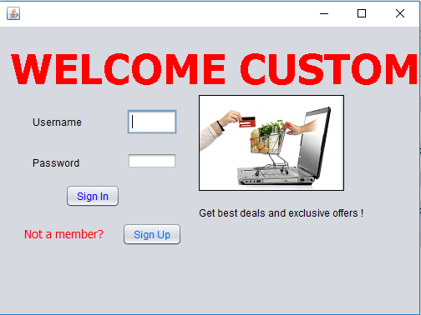
Home-Page

Slide 5
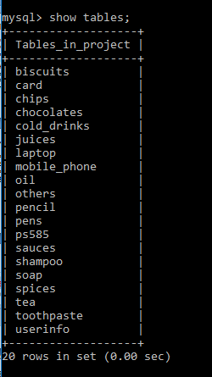
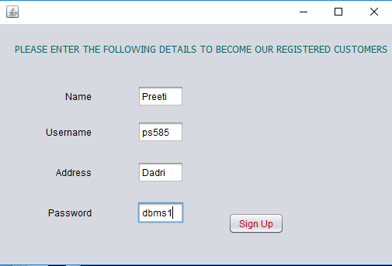
Sign-Up Page
BACK-END
FRONT-END
A Table with the same user-name ‘ps585’ is created.

Slide 6
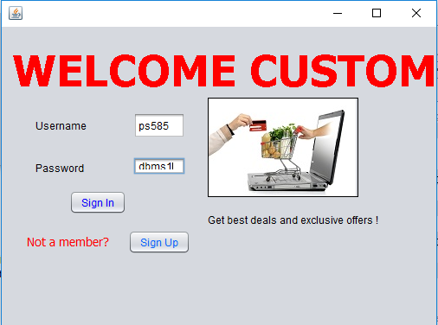
Logging-in with the same username:

Slide 7
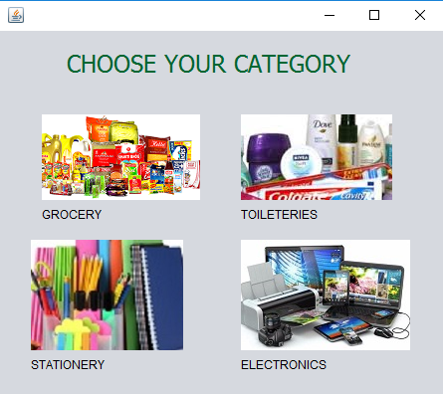
Choosing a Category to buy from:

Slide 8
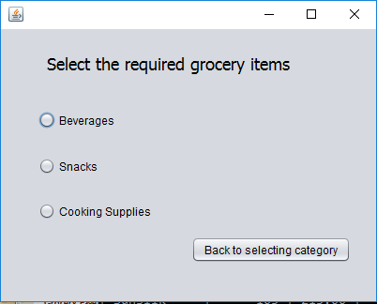
‘Grocery’ Page
BACK-END
There is a table
created for each sub
category which is
present inside
Beverages, Snacks &
Cooking Supplies.
FRONT-END

Slide 9
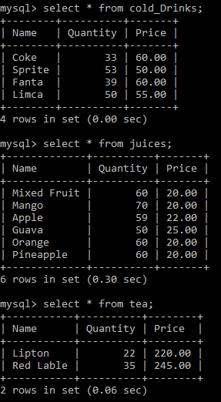
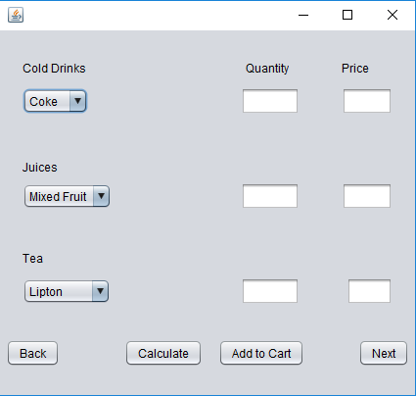
‘Grocery’ Page (Continued)
BACK-END
FRONT-END

Slide 10
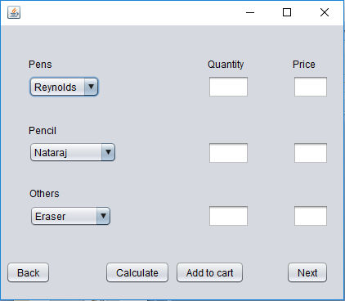
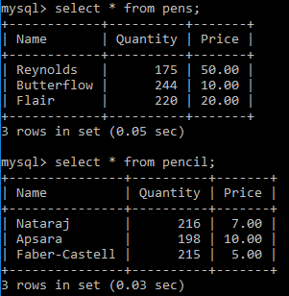
‘Stationery’ Page
BACK-END
There is a table
created for each sub
category, here, Pens,
Pencil and Others.
FRONT-END

Slide 11
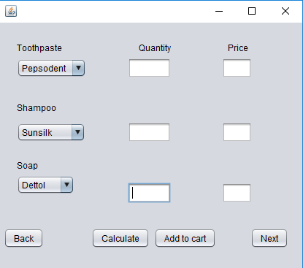
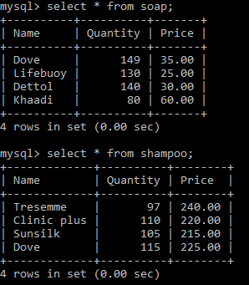
‘Toiletries’ Page
BACK-END
Table for each
Subcategory-
FRONT-END

Slide 12
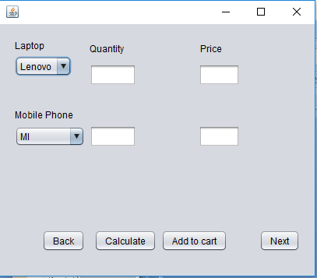
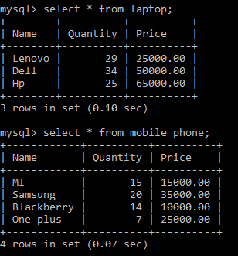
‘Electronics’ Page
BACK-END
Table for each
subcategory-
FRONT-END

Slide 13
BUYING STUFF AND ADDING IT TO CART
First, we choose the item we want to buy from the drop-down menu in each category.
Second, we type in the number of the selected items we want to buy.
On pressing the ‘Calculate’ button, we find the total price of the selected items.
On pressing the ‘Add To Cart’ button, we send this data into a user-specific table created in the back-end.
This table is recalled during payment.

Slide 14
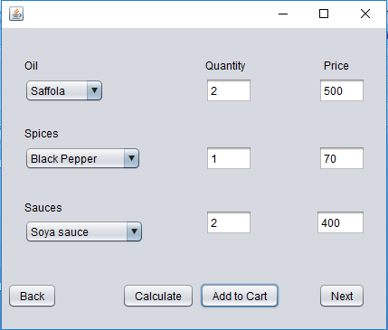
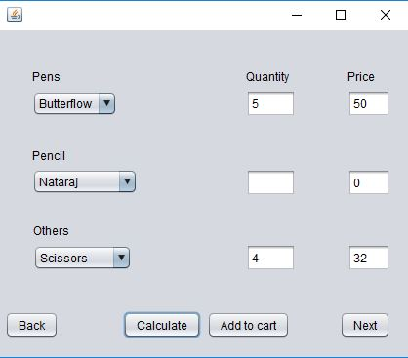
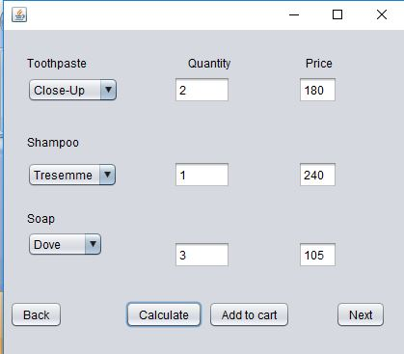
Under ‘Cooking Supplies’
Under ‘Stationery’
Under ‘Toiletries’

Slide 15
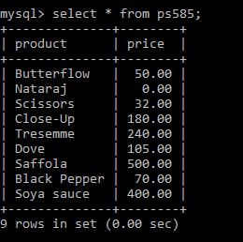
A User-Specific Table is Created with the selected items and respective prices-
Here, the username is ‘ps585’ as created earlier.

Slide 16
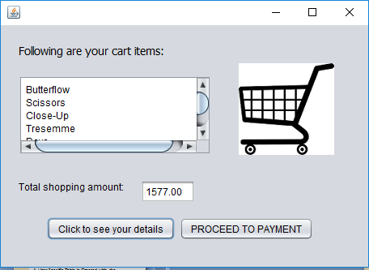
‘Cart’ Page
As soon as the ‘Click to see your details’ button is pressed, the added cart items are displayed on the screen along with the Total Shopping Amount-

Slide 17
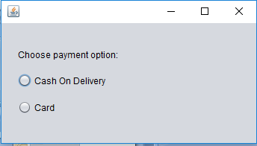
‘Payment’ Page
There are two modes of Payment-
Cash On Delivery
Card

Slide 18
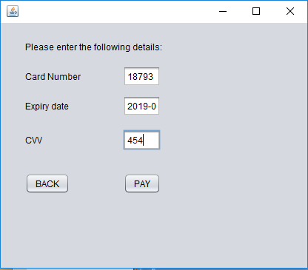
‘Card’ Page
On this page, the user has to enter his Card Details for payment.

Slide 19
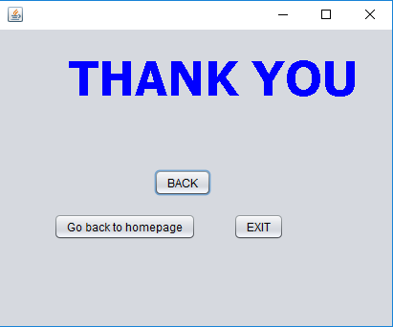
After Payment is done, the transaction is successful and the order has been placed and one can go back to the homepage to place another order.

